Slide 1
Driving action at every touchpoint

Slide 2
Healthcare is at an inflection point
Leaders are redrawing budgets under intense pressure to adapt
Friction drives delays + dissatisfaction
48%
of consumers experience
appointment barriers
Denials continue to rise in volume
and complexity
Up to 20% average denial rate
Patients are less able to pay for care
50%
of Americans can’t afford
a $500 surprise medical bill
Labor shortages are impacting efficiency
63%
of revenue cycle teams are understaffed
Notes:
Healthcare is at an inflection point. Revenue keeps slipping while costs climb. Leaders are redrawing budgets to do more with less—faster.
Pressures are converging that drive this tension:
Affordability squeeze; Premiums are surging, half of Americans can’t cover a $500 surprise bill, and bad debt is up ~20% since 2021. Cash gets pushed further out.
Volume and complexity of denials keep climbing; average rates sit in the high-teens, and unresolved denials can drain up to 5% of net patient revenue.
Talent crush; Revenue-cycle teams are often understaffed, under-trained, and hard to retain. That traps experts into repetitive tasks instead of patient conversations.
Rep pause: Out of curiosity, where do you feel your biggest challenge is right now—experience friction, denials, patient payment, or staff inefficiency? What are ways that you’ve started to combat these pressures?
LISTEN FOR:
-Disjointed experiences
-Vendor management/integration
-More early out services in use… at what day?
-Charity and financial assistance need is higher… how are they managing?
-Being asked to do more with less… Is AI on the horizon?
_________________________________________
Stats sources:
48% of consumers experience appointment barriers – Press Ganey, 2025: Patients as consumers: New research report shows a new era of expectations in healthcare | Press Ganey
Up to 20% average denial rate – KFF, 2025: Claims Denials and Appeals in ACA Marketplace Plans in 2023 | KFF
50% of Americans can’t afford a $500 surprise medical bill – KFF, 2025: Americans’ Challenges with Health Care Costs | KFF
63% of revenue cycle teams are understaffed – Becker’s, 2024: The top workforce challenges facing revenue cycle departments | Becker's

Slide 3
Healthcare’s silent revenue leak.
VISIBLE
CHALLENGES
Legislation / Medicaid Reform
Shrinking Margins
Patient Leakage
Engagement Gaps
Rising Denials
Postage Cost
Historically we’ve been treating the symptoms — but the real revenue leak is structural, silent, and below the surface.
Bad Debt
Patient Satisfaction
Staffing Strain & Cost
HIDDEN
ROOT CAUSES
Patient Affordability Dynamics
Limited Scoring Models
Fragmented Tech Stack
Labor-Heavy Processes
Siloed Pre/Post Care Engagement
Static, Rules-based Workflows
Assumed Patient Behavior
Legacy Collection Policies
Inability for Patients to Self-serve
No Feedback Loop
Inconsistent Provider/Location data
Mismatch Appointments
Notes:
We often see organizations focus on symptoms: patient leakage, rising denials, shrinking margins, engagement gaps, satisfaction risk, postage costs, staffing strain, constant legislation and reform.
But revenue leakage starts below the surface—where data isn’t intelligent or actionable.
Let’s explore how these root causes are driving issues:
•Inconsistent provider and locations data -> breaking patient trust
•Fragmented tech stack -> low conversion, patient frustration
•Affordability blind spots → write-offs, stalled plans.
•Static rules → missed exceptions → first-pass denials.
•Manual steps → higher cost-to-collect, slower cash.
•Limited scoring → generic outreach → low response + higher mail/postage spend.
•Siloed pre/post → missed auths & no-shows → denials.
•Assumed behavior → data defects that don't drive action
Historically we’ve treated the symptoms—write a new policy, add a QA step—but the real leak is structural and silent.
The good news: you have more control than you think. When you bring intelligent, patient-level insight into your system—scoring, affordability signals, dynamic workflows—you cut denials at the source, lower cost-to-collect, and protect margins.
Question: Which root causes that feel most familiar in your world?

Slide 4
A streamlined, personalized patient experience
Search
Estimate
Schedule
Engage
Pay
Eliminate confusion and missed appointments with verified provider information and smart search experiences.
Build trust and confidence by showing patients what to expect — reducing surprise bills and improving financial readiness.
Simplify access to care and reduce call-center volume with self-service, availability-aware scheduling.
Personalized, omnichannel reminders, updates, and follow-ups improve satisfaction and reduce no-shows.
Provide frictionless digital options — from pre-service estimates to post-care balances — all within one branded experience.
Applied intelligence
designed to optimize every interaction
Trusted provider and location data
Patient identity, eligibility, and coverage
Access and scheduling context
Communication preferences and engagement signals
Behavioral and financial insights
Payment history and affordability scoring
Notes:
To succeed today - Disparate point solutions and slow deployments are giving way to unified, data-driven engagement across the care journey.
Here’s how we create a highly personalized, seamless experience that drives action at every touchpoint to help organizations succeed with the new playbook:
We start with the initial search for care. Accurate listings and reputation management allow consumers to view accurate information on providers and facilities, wherever their search begins. Once on your website, patients can view real-time availability and refine search results based on personal preference. A patient self-schedules in minutes and gets an instant confirmation. At their convenience they complete digital pre-registration, receive an accurate cost estimate with payment options, and get timely, OmniChannel reminders. That reduces no-shows and sets expectations before they arrive.
During the visit, check-in is digital—on their phone or a kiosk—so there’s no clipboard. Smart forms and AI-powered OCR handle insurance and consents, and co-pays can be taken care of up front. Staff get time back, throughput improves, and patients move quickly to care.
Post-Care, the first bill isn’t just a statement—it’s a personalized digital experience. One tap into a branded portal guides each patient to the next best action: pay in full, split into installments, or enroll in a plan—driven by financial scoring.
Because outreach is tailored by message, timing, and channel, most patients stay on track with little to no follow-up. Automation handles the rest—keeping payment plans active and eliminating costly collections.
The outcome: earlier payments, fewer statements, lower call volume, reduced bad debt and days in A/R—and a better patient experience that builds loyalty.
_______________________________________________________________________________________________________________________
Kyruus contributes the source-of-truth for providers and locations + plan context to enable accurate find & schedule.
RevSpring contributes member-level engagement & payment intelligence to activate, complete, and pay—and feeds those completion signals back to improve steerage.

Slide 5
Premier communication and payment provider
Apr 2014
Acquired
Talksoft
Sep 2015
Acquired Healthcare Revenue Strategies
Mar 2020
Acquired
Loyale
Mar 2024
Frazier Healthcare Partners Acquires RevSpring
Feb 2026
Acquired
TrustCommerce
Our history
Acquire companies
to complement and enhance
our primary offerings
Apr 2012
RevSpring formed by merger of PSC Info Group, Dantom Systems, Data Image and Best Bill
Apr 2015
Acquired
Revenue Advantage
Oct 2018
Acquired Apex
Revenue Technologies
May 2021
Acquired
SmartCycle
October 2025
Acquired
Kyruus Health
Our history
Acquire companies
to complement and enhance
our primary offerings
Our strength
Invest in technologies
to become best of breed in
communications and payments
Our goal
Resources of a large organization
speed and customer-focused culture
of a small company
Notes:
RevSpring began in 2012 as a roll-up of category-leading print and mail businesses, giving us scale, compliance rigor, and cash flow in a highly regulated space. From that foundation, we’ve systematically moved up the stack to digital engagement and payments.
We added patient reminder and messaging capabilities (e.g., Talksoft), expanded revenue-cycle and payment expertise (Revenue Advantage, Healthcare Revenue Strategies), brought in data-driven statement design (Apex), and then a modern patient financial engagement platform with embedded payments (Loyale). We continued with workflow automation (SmartCycle).
Backed by Frazier Healthcare Partners, we’re shifting mix from paper to OmniChannel—text, email, portals, and self-service checkout—driving faster collections, lower bad debt, and better patient experiences.
To further push our solutions upstream, we've recently acquired Kyruus Health, the leading care access platform, to now deliver optimized provider and location data and patient acquisition solutions while simultaneously expanding our access offerings. The Kyruus acquisition also opens new markets for RevSpring by bringing us into the Payer space with member engagement solutions.
To-date, we’ve built a durable cash-generating print core that funds a faster-growing, higher-margin digital and payments engine, with meaningful runway.

Slide 6
Proven at scale
740+​ | Hospitals and health systems
2,500+​ | Ambulatory care organizations
110+​ | Health plan brands
250+​ | Partners
30+ | Integrations
Providers
Payers
Print Facilities
Notes:
RevSpring is trusted at scale across healthcare, supporting 740+ hospitals and health systems, 2,500+ ambulatory organizations, and 110 health plan brands, with 30+ EHR integrations. We’re proven, embedded, and built to scale.

Slide 7
Impact at every step
From search to payment—RevSpring enables frictionless patient experiences at scale.
1B+
Care searches
$55B
Collected annually
284M+
Payments processed annually
5M+
Scheduled Appointments
700M+
Digital communications sent per year
500,000+
Connected Providers
1B
Printed communications mailed / year
Notes:
RevSpring operates at true national scale, across both print and digital. We lead with digital engagement—facilitating over 220M care searches, sending more than 700 million texts, emails, IVR messages, and portal notifications each year—while still delivering over 1 billion printed communications where that channel performs best. That breadth lets us meet every patient in the channel they prefer, optimize cost-to-collect, and maintain operational resiliency.
On the payments side, we’re processing 60-plus million transactions annually and collecting more than $14 billion each year on behalf of providers. That volume gives us unmatched behavioral data and benchmarking to continuously tune outreach and move more payments to convenient, lower-cost digital flows—accelerating speed to cash while preserving the reliability of print.
____________________________________________________________________________________
These numbers represent the trust the industry places in our combined platform and the impact we drive across the full care journey.
1B+ care searches:
Every year, more than a billion people search for care through experiences we power. That volume underscores the importance of accurate data and intuitive navigation—because this first step shapes cost, access, and outcomes for everyone involved.
5M+ scheduled appointments:
Turning intent into action is where value is created—better continuity of care, reduced leakage, and improved patient and member satisfaction across networks.
500,000+ connected providers:
A half-million providers connected through validated, normalized data creates the foundation for consistent experiences—whether someone is searching, scheduling, referring, or engaging.
60M+ payments processed annually:
We support payment workflows at massive scale, helping organizations streamline revenue cycle operations while giving consumers clearer, more flexible ways to pay.
700M+ digital communications per year:
From reminders to bill notices, we enable high-volume digital outreach that drives action, closes care gaps, and supports operational efficiency.
1B printed communications mailed:
Print remains essential—particularly for regulated programs and harder-to-reach populations. Our ability to reliably deliver at this scale ensures compliance and accessibility for all.
Whether you’re a payer or a provider, our platform delivers the scale, reliability, and intelligence needed to create seamless, end-to-end experiences—from search to final payment.

Slide 8
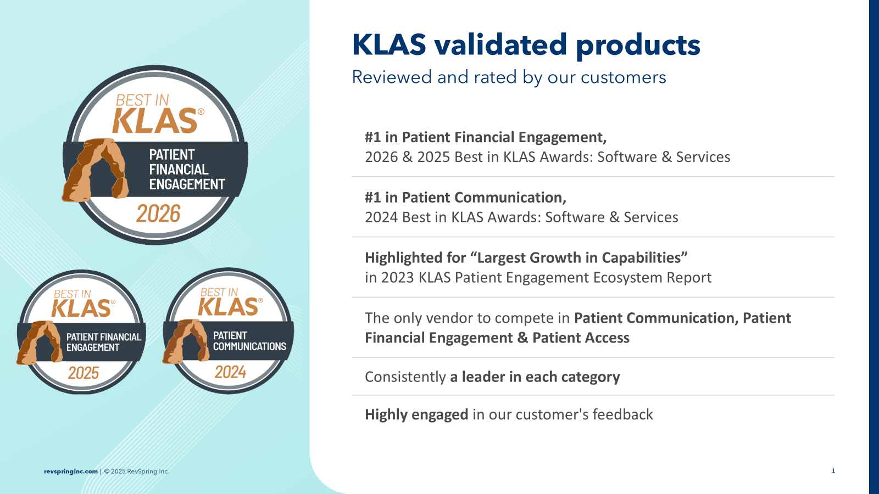

KLAS validated products
Reviewed and rated by our customers
#1 in Patient Financial Engagement, 2025 Best in KLAS Awards: Software & Services
#1 in Patient Communication, 2024 Best in KLAS Awards: Software & Services
Highlighted for “Largest Growth in Capabilities” in 2023 KLAS Patient Engagement Ecosystem Report
The only vendor to compete in Patient Communication, Patient Financial Engagement & Patient Access
Consistently a leader in each category
Highly engaged in our customer's feedback
Notes:
We are continually recognized as a leader by KLAS and other organizations in Patient Engagement and Communications - rated #1 in Patient Financial Engagement in 2026 AND 2025 Best in KLAS Awards, and #1 in Patient Communication in 2024. In the 2023 Patient Engagement Ecosystem report, KLAS also highlighted RevSpring for the largest growth in capabilities.
RevSpring is the only vendor spanning communication, financial engagement, and access—and a consistent leader in each. The takeaway: trusted by the market, differentiated across the full journey, and positioned to drive sticky growth and margin expansion.

Slide 9
Driving action. Engineering outcomes.
RevSpring works across the patient journey, from first search to final payment.
Accessing care
Paying for care
Search for care
Online scheduling
Merchant
processing
Guided CSR
scripting
Cost estimate
Digital intake
Prescribed
workflow
Performance dashboards
Guiding patients to the right care
Driving improved payment outcomes
Listings
management
Copay
collection
Self-service
payment portal
Digital & printed engagement
Reputation management
Insurance
eligibility
Personalized
payment options
Voice
automation
Notes:
RevSpring is the only unified ecosystem that connects care discovery, engagement, and payments into one actionable journey.
Powered by a foundation of robust data, RevSpring has solutions that stretch across the entire care journey.
To create self-service patients:
Search
Cost estimates
Online scheduling
Digital intake
Payment portal
Payment options
Print
Voice automation
To streamline internal processes for staff:
Listings management
Reputation management
Copay collection
Insurance eligibility
Merchant processing
Prescribed workflows
Guided CSR scripting
Performance dashboards

Slide 10
Engaging patients with intelligence, empathy, and precision

Slide 11
RevSpring Client Solutions
Live Solution
Core EMR
In-Flight Project
Active Discussion
PRE CARE
POST CARE
Patient Acquisition and Access
Patient Search and Intake
Portal and Payments
Print and Mail
270/271 Eligibility
Patient Self-Scheduling
Self-service Payment Portal
Printed Patient Statements & Letters
Patient Estimation
Typeahead Response Search
Payment Gateway
Printed Detailed Bills & Invoices
Medical Necessity
Provider & Location Directories
Deviceless Payments & Text to Pay
Printed Claims & Medical Records
Registration Quality Assurance
Digital Intake & eSignature Forms
Merchant Processing
Insight Driven Statement Design
Insurance Coverage Discovery
Appointment Reminders & Visit Communication
PCI Compliant Payment Tech & Devices
Analytics and Scoring
Data Management
Co-Pay and Pre-Service Payments
Guarantor Analytics Dashboard
Provider & Location Data Management
OMNI CHANNEL COMMUNICATION
Demographic Channel Scoring
Listings Management
AI
Multi Channel Communication
Behavioral Payment Propensity Scoring
Reputation Management
CSR Agent Support Scripting & AI
Digital Patient Communication
Demographic Payment Propensity Scoring
Clinical Libraries & Taxonomy
Conversational IVA
IVR Advantage (outbound)
Affordability & Charity Scoring
IVR Advantage (inbound)
Notes:
Internal use only: This slide is intended to support customer conversations around solution alignment and future growth. Use it to identify which capabilities the customer is currently using, highlight adjacent solutions they may not yet have, and guide cross-sell discussions. This view can also help frame a longer-term roadmap by showing how customers can expand their partnership with RevSpring over time as their needs evolve.

Slide 12
Where should we go next to support your evolution?
Explore a proof of concept
Deep dive into a specific area
Schedule a demo

