Slide 1
Product Overview Slides - Index
To view the overview slides for each product, click the link below to go to the corresponding section:
True Access – Patient Access
Intake & Access - Combined
Arrived – Patient Intake
Forms Blast
Digital First
Voice Solutions
PersonaPay
Merchant Services
Analytics
Print
Omni Brain

Slide 2
True Access
Patient Access
Solutions

Slide 3
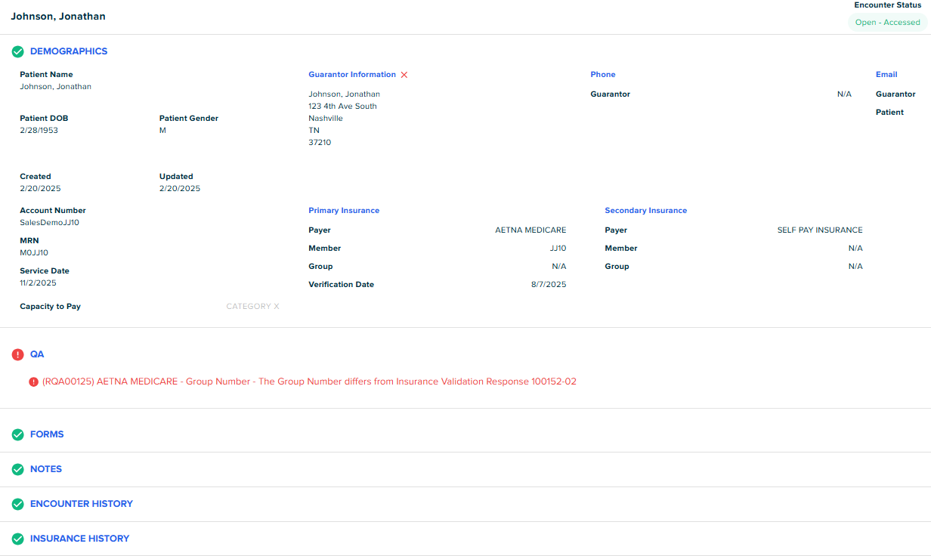
Achieve frictionless care journeys with True Access
Reduce denials and accelerate reimbursement with automated data QA
Build patient trust through accurate estimates and flexible payment options
Boost efficiency and ease workloads with intelligent digital registration tools and workflows
Notes:
(Accurate data, trusted estimates, and a streamlined workflow.)
Ensure data accuracy from the start: Our automated QA process catches errors before they lead to denials, so you get cleaner submissions and faster reimbursement.
Build patient trust with accurate estimates: By providing reliable cost estimates up front, you help patients feel more confident about their care decisions.
Streamline staff workflows and reduce workload: Digital automation tools free up your team to focus on patient care instead of paperwork.

Slide 4
Comprehensive capabilities across the journey
Estimate of Patient
Financial Responsibility
Estimate based on patient's insurance coverage and provider's contractual rates with payers. Meets requirements for Price Transparency.
Preservice Payments
Embedded PersonaPay with integrated merchant processing for full-featured payment options that are equivalent to the payment portal experience.
Registrar
Workflow
Workflow-oriented registrar tool focused on preservice financial clearance.
Patient Pre-Registration Portal
Patient-facing pre-registration portal that allows patients to self-serve pre-registration tasks.
Patient
Engagement
Include estimation and payment options in patient communication by text, email, and IVR using RevSpring's existing capabilities.
Integration & Automation
HL7 registration and scheduling interfaces and EHR integration.
Notes:
(Streamline workflows, enhance accuracy, and improve the patient experience.)
Patient Estimator: Provide patients with clear, accurate cost estimates to build trust and reduce financial confusion.
Patient Financial Clearance: Quickly verify insurance eligibility and coverage, minimizing delays and denials.
Digital Registration Portal: Let patients complete paperwork online, reducing manual data entry and improving accuracy.
Automation and Workflow Integration: Seamlessly connect these tools to your existing systems to streamline staff workflows and improve overall efficiency.

Slide 5
Driving results from access to outcomes
26%
fewer denials through registration quality assurance
2/3
reduction in front desk workload with intelligent workflows
5%
increase in preservice collections with personalizedpayment options
Notes:
Now, let’s look at the real impact. With our Patient Access solution, our clients have seen an average of a 26% reduction in denials, thanks to the automated quality assurance we’ve built in. They’ve also experienced a 40% reduction in staff workload by eliminating the need for manual follow-up. Finally, we’ve increased upfront collections by 5% by providing patients with reliable estimates and convenient digital payment options. This is how we turn access challenges into measurable success

Slide 6
THE REVSPRING
Preservice Advantage
Arrived™ Patient Intake
  An engagement solution for the patients
  The two are working together, hand in hand
  Most vendors serve only one side well. RevSpring combines the power and intelligence of both for a connected preservice experience.
  We don’t stop there.
  Our strong experience in backend payment solutions with merchant processing are leveraged and integrated into
  preservice to create the most seamless, intelligent payment journey for the patient­.
  +
True Access™ Patient Access
  A workflow solution
  for the registration staff
Notes:
Our solution isn’t just about individual tools—it’s about bringing everything together. By combining patient intake and access with integrated payment solutions, we streamline the entire pre-service journey for both patients and staff. This means fewer handoffs, reduced administrative burden, and a more efficient process from start to finish. In short, it’s a holistic approach that turns fragmented steps into a single, smooth experience.

Slide 7
Arrived
Patient Intake
Solutions

Slide 8
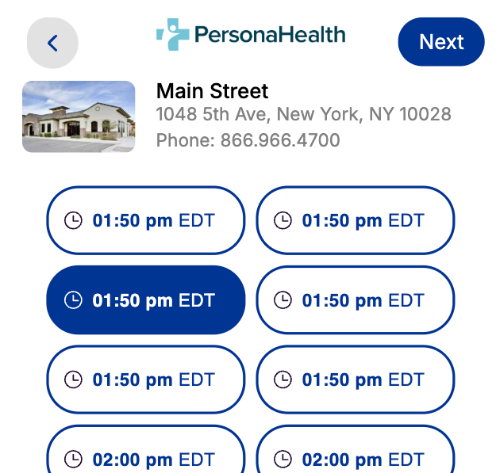
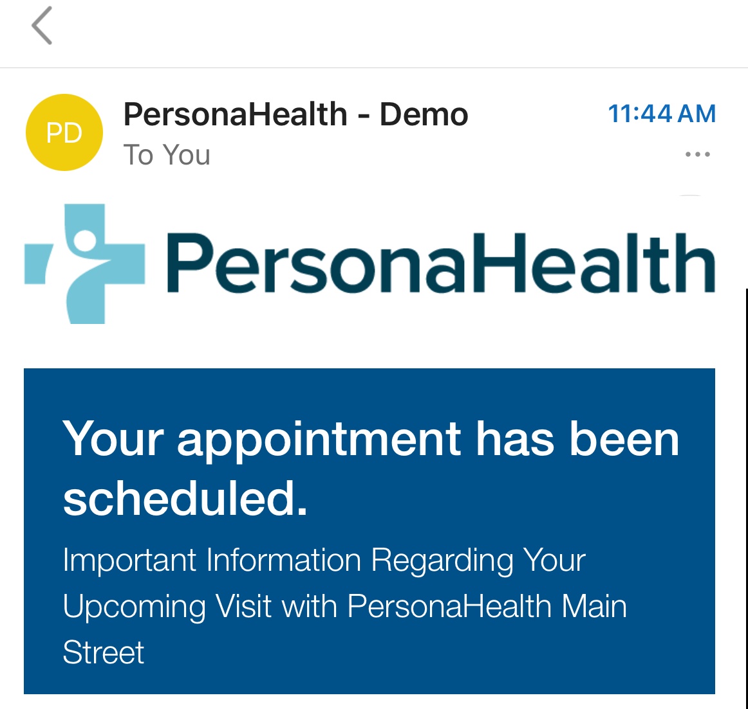
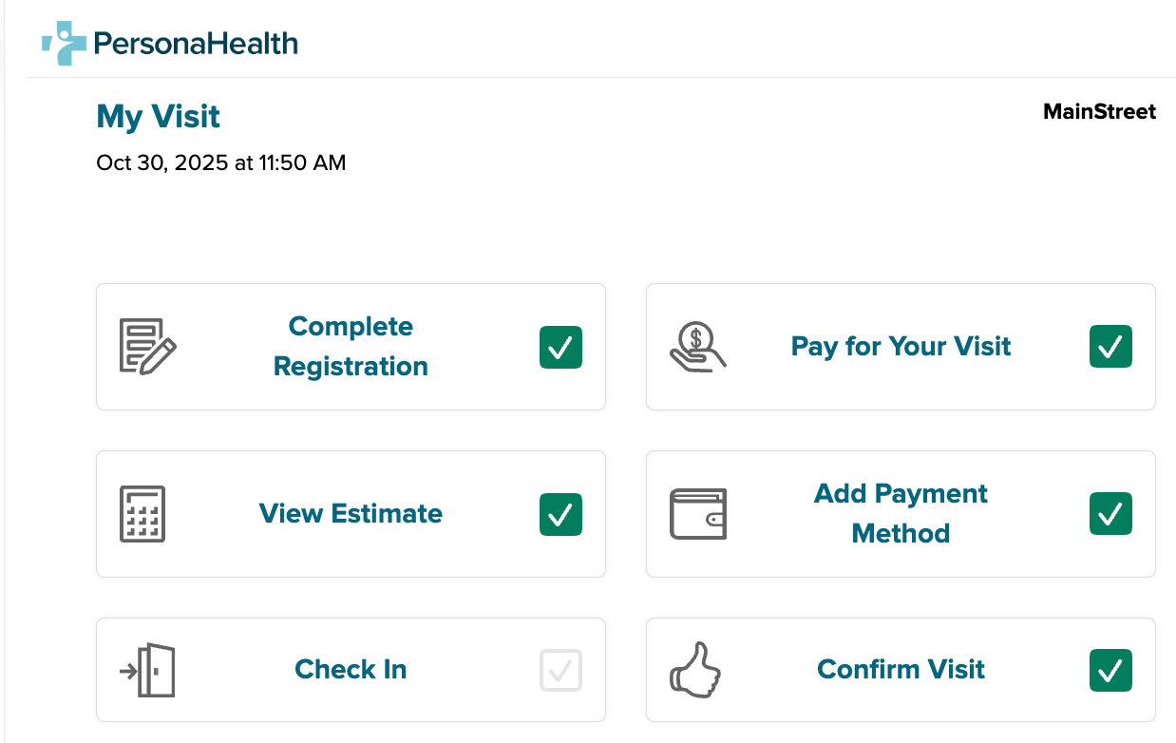
A better, faster check-in experience
Easy self-scheduling options
Reduce call volume and no-shows with convenient, online self-scheduling for patients.
Simple digital
check-in
Save staff time and shorten wait times by allowing patients to complete forms, make pre-service payments, and check-in digitally before they arrive.
Helpful reminders
& updates
Reduce missed appointments and improve communication before, during, and after visits with Talksoft reminders and patient messaging.
Notes:
Our digital check-in experience gives patients easy self-service scheduling, a pre-service portal to track their check-in, and Best in KLAS Talksoft appointment reminders to drive adherence. By putting patients in control before they arrive, we reduce front-desk workload and streamline intake and check-in for staff.

Slide 9
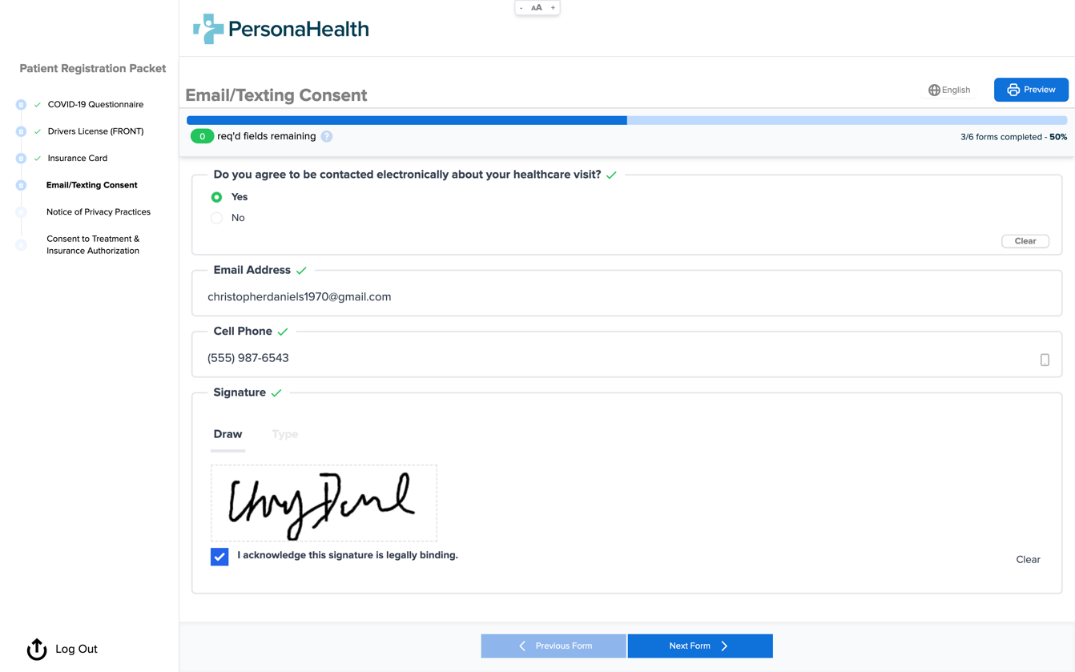
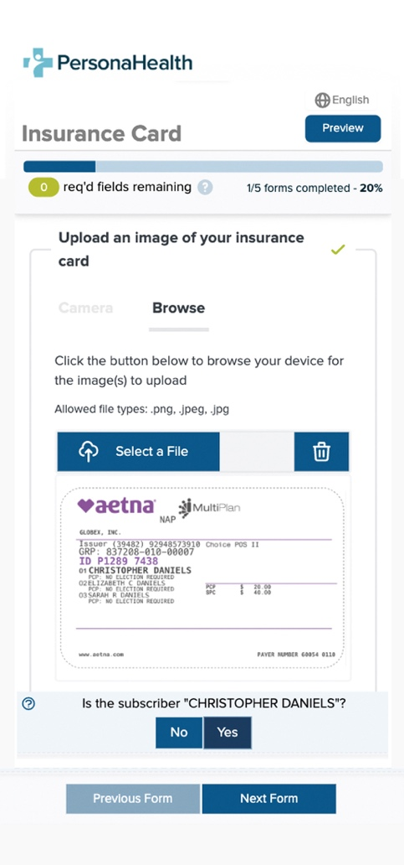
Dynamic patient intake forms
Modernize intake with dynamic forms tailored by appointment type and mapped to your existing workflows
Capture documents effortlessly with auto-focus, auto-capture, and auto-crop—no manual adjustments or retakes
Extract and structure data instantly with enhanced AI that improves accuracy and reduces manual entry
Speed up intake by automatically sending verified data and clean, formatted PDFs directly into your systems
Notes:
Our AI-powered digital forms make it easy for patients to enter their information accurately from the start. The system intelligently verifies and standardizes the data, reducing the risk of errors and minimizing the need for manual corrections. This not only saves time for your staff but also ensures that all information is complete and ready at the field level before the visit, creating a smoother experience for everyone.

Slide 10
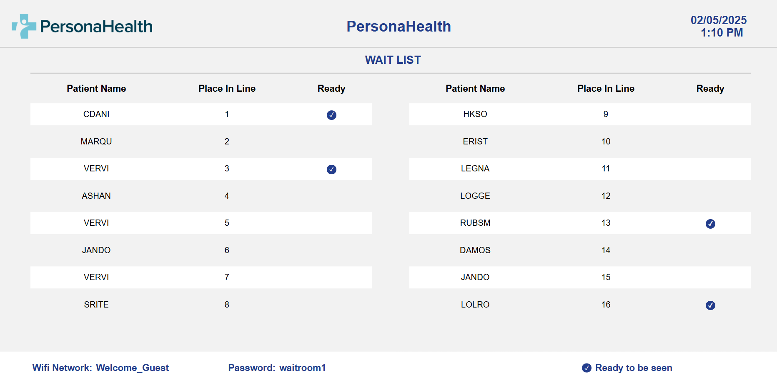

Streamlined waiting room experience
Display real-time place in line to set clear expectations for walk-in patients
Show registration process so patients know if they’re fully checked in
Support self-check in with an optional QR code to join the line instantly
Keep patients informed and engaged with a clear, easy-to-read screen display
Notes:
One of the biggest pain points in a waiting room is not knowing how long you’ll be there. With our virtual waiting room, patients can see exactly where they stand in line. They get real-time updates on their place in the queue, so they feel more informed and less anxious about wait times. It’s a simple but powerful way to enhance their experience, keep them engaged, and make the waiting room feel a lot more transparent.

Slide 11
OmniBrain
Forms Blast
Modernize your patient experience & improve outcomes with digital forms & intelligent, automated campaigns

Slide 12
Collect data easily with Forms Blast
Forms Blast is an intelligent, automated forms campaign engine
that enables your organization to:
Simplify
data collections
Improve
engagement & response rates
Analyze
results through detailed reporting
Tailor
journeys to optimize outcomes
Notes:
Forms Blast transforms the way healthcare organizations collect information by replacing manual, repetitive processes with intelligent automation.
Through automated digital campaigns, Forms Blast sends the right forms to the right patients at the right time — simplifying data collection and improving engagement and response rates.
You can tailor campaigns to fit specific points in the patient journey, creating personalized experiences that drive better outcomes. And with detailed reporting and analytics, you can measure performance, identify trends, and continuously optimize your approach.
It’s a smarter, more efficient way to capture complete, accurate information — while freeing staff to focus on care, not paperwork

Slide 13
Essential features
  Customer Features
  Support for a variety of use-cases
  Customizable to meet unique needs
  OCR Technology to automatically capture information from images
  Daily return file with detailed engagement activity
  Completed PDF return
  Dynamic forms can guide users to complete additional forms based on previous responses, such as financial assistance forms
  Patient/Consumer Features
  Omnichannel delivery through SMS,
  email, and print if needed
  Journeys are personalized based on the goal for each patient
  Secure, HIPAA-compliant portal to capture sensitive information
  Fields can be pre-populated with known information
  OCR Capture to automatically scan and input insurance, driver's license, and other information
  Autosaved progress to prevent data loss
  eSignature capture to securely and efficiently obtain authorization
Notes:
Forms Blast supports a wide range of use cases across the patient journey — from intake to follow-up — and is fully customizable to fit any workflow.
It uses OCR technology for accurate data capture and supports both field-level and PDF document return. Forms can be delivered through multiple channels like text or email, with personalized journeys, pre-populated fields, autosaved progress, and secure eSignatures.
And with HIPAA-compliant security built in, you can collect data confidently while giving patients a seamless, digital experience

Slide 14
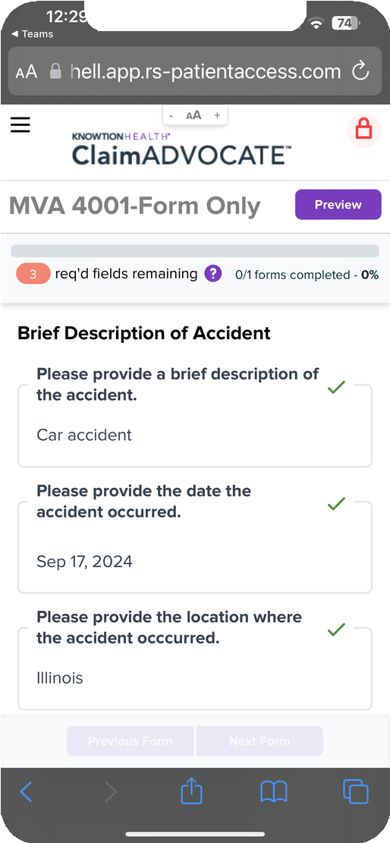

Forms Blast Results
Accident Questionnaire
Forms are often completed within 2 days of sending a digital message
Over 35% completion rate
without manual outreach
Enhanced user experience
with dynamic forms
Notes:
With Forms Blast, organizations are seeing real, measurable results.
On average, forms are completed within just two days — and 35% of patients complete them without any manual outreach from staff. That means faster data collection, less administrative effort, and more time focused on care.
At the same time, the intuitive, digital experience enhances patient satisfaction, making it easier and more convenient to engage at every step.

Slide 15
Digital First

Slide 16
Our Digital First advantage
Using the Best Channels
Making Them
Work Together
With Best Practices Driven by Data
Cut postage spend by 25-30%
Strategic statement delivery that combines digital + print to minimize unnecessary mailing costs.
Improve engagement.
Modernize engagement by reaching patients through the channels they actually respond to.
Increase response, increase payments.
Digital first not only lowers cost – it improves yield by up to 7% by using intelligence to determine the best path for each patient.
Notes:
With a Digital First strategy, providers can finally balance cost savings with better patient engagement.
By prioritizing digital statement delivery, organizations can significantly reduce postage spend while improving communication and convenience for patients. The result is faster payments, higher response rates, and a more modern billing experience that strengthens loyalty and improves overall financial performance.

Slide 17
How Digital First delivers
Start with digital.
Only print when there’s no engagement
Engaging patients through adaptive, AI-powered communication that starts digital, reducing print, and simplifies the path to self-service payments.
AI + Scoring
models adapt journeys to optimize outcomes
Drive patients
to the portal for self-service payment options
Notes:
Digital First starts with a simple principle — send communications digitally first, and only print when there’s no engagement.
AI and intelligent scoring models analyze patient behavior to adapt each journey, ensuring messages are sent through the channels that work best for every individual.
Patients are then directed to a personalized payment portal, where they can easily view their statements, explore tailored payment options, and complete payments in just a few clicks.
It’s a smarter, data-driven approach that meets patients where they are — and accelerates revenue collection without sacrificing experience.

Slide 18
The impact of Digital First engagement
20%
Average Increase in
Self Service Payment
Up to 30%
In reduced
postage costs
90%
Digital reach
Payments received
on average
6.5 days faster
Low opt-out rates of around
1% per touchpoint
3-7%
Increase in yield with personalized engagement
Notes:
Organizations that have adopted a Digital First approach are seeing measurable results across every key metric.
They’ve achieved significant reductions in postage costs while accelerating payment speed and increasing overall yield. Patients are engaging more — with a major increase in self-service payments and faster digital responses.
It’s proof that when you prioritize convenience and intelligence in communication, you don’t just save money — you improve both patient satisfaction and financial outcomes.

Slide 19
Voice Solutions

Slide 20



Conversational AI that enhances, not replaces
Reduce inbound call volume beyond 30%, optimizing staff time and reducing workload
Take patient interactions further with AI-driven automation that goes beyond payment calls—handling more inquiries, improving response accuracy, and providing 24/7 support.
Increase patient satisfaction
with personalized support and self-service—with 0 wait time
Power smarter conversations with AI that extends RevSpring application expertise
Notes:
Conversational AI is the next evolution of patient communication — designed to enhance staff performance, not replace it.
It goes far beyond traditional IVR or basic automation by using natural language understanding to handle a wide range of inquiries — from common FAQs to payments, appointment scheduling, prescription refills, and more.
Patients get fast, accurate, and personalized responses 24/7, while staff are freed from repetitive calls so they can focus on higher-value, complex interactions.
It’s intelligent automation that improves efficiency, boosts satisfaction, and ensures every patient gets the help they need — anytime, from anywhere.

Slide 21
Smarter conversations start here
Resolve More on the First Call
Address scheduling, payments, and questions in one natural interaction.
Always-On Support
Extend coverage after hours without adding staff.
Enhance IVR Performance
Add conversational intelligence to improve accuracy and experience.
Reduce Staff Burden
Automate routine requests so teams focus on complex needs.
Ensure a Consistent Experience
Deliver a unified voice across IVR, AI, and live channels.
Learn and Improve Over Time
AI continually adapts to expand automation and efficiency.
Calling…
Let’s Talk AI Assistant
Experience it for yourself!
Dial 888-225-1350
Try asking about…
  What to bring with you to an appointment
  Office hours and location
  Making a payment
  Refilling a prescription
  Rescheduling an appointment
Notes:
Conversational AI is the next evolution of patient communication — designed to enhance staff performance, not replace it.
It goes far beyond traditional IVR or basic automation by using natural language understanding to handle a wide range of inquiries — from common FAQs to payments, appointment scheduling, prescription refills, and more.
Patients get fast, accurate, and personalized responses 24/7, while staff are freed from repetitive calls so they can focus on higher-value, complex interactions.
It’s intelligent automation that improves efficiency, boosts satisfaction, and ensures every patient gets the help they need — anytime, from anywhere.

Slide 22
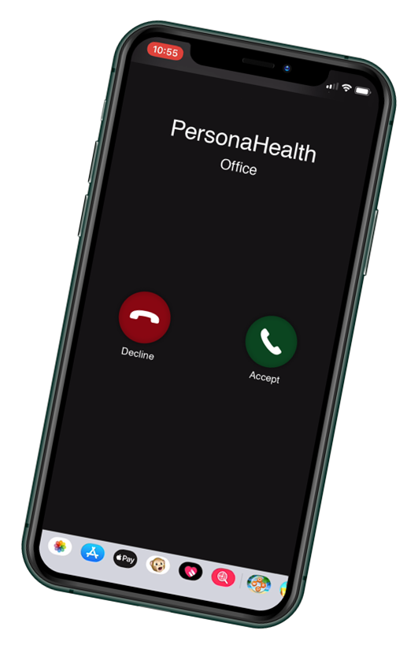
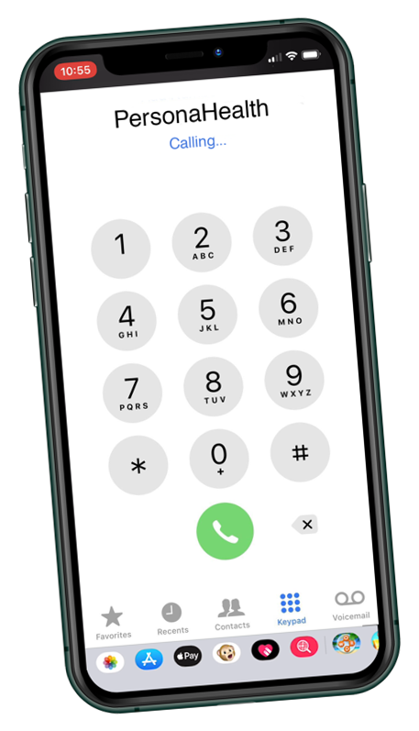
Inbound + outbound IVR: A smarter, connected experience
Offload up to 30% of inbound calls with automated self-service options for payment and account info
Enable secure, automated payments so patients can pay anytime – without waiting for staff
Empower your team to focus on complex or high-value interactions
Accelerate payments with outbound IVR that delivers reminders, take payments, or leaves voicemails prompting a call back
Create a closed-loop experience – patients can return the call to the inbound IVR and complete payments instantly
Notes:
For organizations not quite ready for Conversational AI, our inbound and outbound IVR solutions offer a reliable, cost-effective way to streamline patient communication.
Outbound IVR can automatically send reminders for payments, appointments, or important updates — reducing missed opportunities and manual outreach. When a patient receives a message and calls back, the inbound IVR takes over, guiding them through an easy, menu-based experience to make payments, confirm appointments, or get the information they need.
Together, inbound and outbound IVR create a closed-loop experience — automating communication from start to finish, improving response rates, and freeing staff to focus on higher-priority calls. It’s the foundation for efficient, patient-friendly voice engagement

Slide 23
PersonaPay
“We went from about 30k a month to about 100k a month when we switched to PersonaPay.”
Manager Patient Financial Engagement, 2025 Customer Survey
Notes:
Healthcare payment complexity is no longer a back-office issue—it’s a patient experience and financial performance issue. Patients are taking on more responsibility, but the systems designed to collect those payments haven’t kept pace. As a result, organizations are seeing slower cash flow, rising bad debt, and frustrated patients who don’t understand what they owe or how to pay.

Slide 24
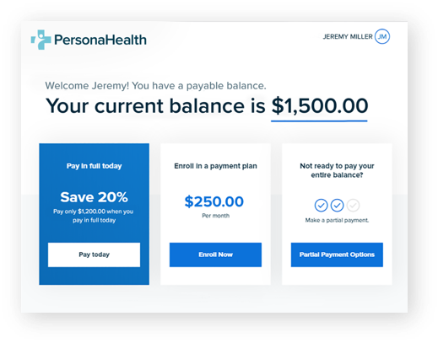

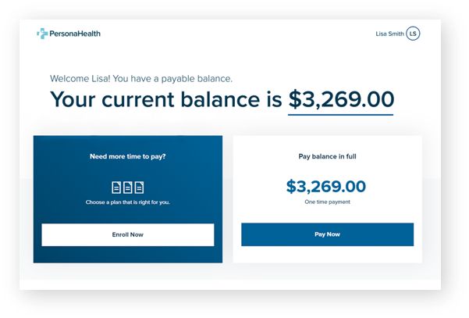
PersonaPay: bridge the gap between expectation and reality
Improve payments with a personalized approach for each patient
Decrease call volume with easy self-serve options
Empower CSRs to have the right payment conversation with every patient
Improve patient loyalty by meeting individual payment needs
Drive self-service by offering an intuitive and easy to use payment option 24 hours a day
Notes:
PersonaPay closes the gap between what patients expect and what healthcare delivers. Instead of a one-size-fits-all approach, we tailor the payment experience to each patient—how they want to pay, when they’re most likely to act, and what option is most realistic for them. PersonaPay isn't just a portal, it is an experience that meets the needs of each patient.
What percentage of your payments are handled fully self-serve versus requiring staff involvement?

Slide 25
Simplified, secure transactions – no hardware needed
Seamless Across Every Channel
Accept payments anywhere: in-person, over the phone, or online—no hardware required.
Secure & Compliant
PCI Level 1 hosted environment; no card data ever touches your network.
Protects patients and reduces compliance scope.
Better Patient Experience
Offer modern, contactless options—text-to-pay, Apple Pay, Google Pay, ACH.
Build trust through fast, familiar, consumer-grade payment experiences.
Build trust through fast, familiar, consumer-grade payment experiences.
Notes:
RevSpring can offer devices where needed, however, with PersonaPay payments are completely deviceless. There’s no hardware to deploy, no devices to sunset, and no card data ever touching your environment. Everything happens in our PCI Level 1 hosted platform. That means CSRs can accept payments securely over the phone or via text or email links, patients can pay online or mobile, and your organization dramatically reduces PCI scope — without slowing down the payment experience.
The result is a faster, more familiar, consumer-grade transaction for patients, while IT and finance teams eliminate hardware spend, reduce compliance burden, and remove a major operational risk.
How many different vendors or systems are involved today when a patient pays — portal, IVR, devices, reconciliation?
Do those systems talk to each other in real time, or is reconciliation still manual?

Slide 26
PERSONAPAY PROVEN IMPACT: Users consistently outperform national averages on collection speed, yield, and patient satisfaction.
+1.55%
average lift in payment rate,
translating to $250K–$2.3M
in additional revenue per health system.
2.5×
increase in eBill adoption drives faster digital engagement.​
65%
of payments now completed via
self-service, reducing call center burden.​
Providers see
15–30%
savings on print and mail costs.​
Patients pay 11 days faster on average when offered digital-first options.
“
“
We went from about 30k a month to about 100k a month when we switched to PersonaPay.”
Manager Patient Financial Engagement, 2025 Customer Survey
Our self-service has increase from 13% to 25% using PersonaPay”
– Omni-Channel Manager, 2025 Customer Survey
Individual results may vary based on organizational size, current performance, and implementation scope.
Notes:
Across our client base, PersonaPay delivers measurable financial lift—205k-2.3M in additional revenue, faster payments by nearly two weeks, and significant reductions in print and call center costs.
PersonaPay is an important piece of the puzzle—RevSpring brings everything together—payments, merchant services, analytics, and communication—into one coordinated experience.
We simplify complexity, reduce risk, and help healthcare organizations collect more while treating patients better.
Do you want to learn how analytics or merchant dives deeper into personalized outcomes to drive even more yield?

Slide 27
Merchant Services

Slide 28
Revspring Merchant Services enable payments throughout the entire patient journey
$53.5 billion processed transactions yearly through our technology—growing 25% YoY
$6.3 billion using RevSpring merchant services—growing 50% YoY
Pre-Service
Point-of-Service
Post-Service
Follow-Up
Minimize complexity and close the loop on patient payments
We are large enough to give you the rates and services you deserve, but nimble enough to tailor to your needs
Eliminate the need to manage multiple processing relationships and transaction fees
Leverage our buying power we pass on with competitive rates
Notes:
RevSpring enables payments across every step—portal, text-to-pay, IVR, devices, and lockbox—so you don’t stitch together point tools. We process ~$15B annually through our technology, with 25% YoY growth; $5.5B+ now runs on our own merchant services, growing 50% YoY. Our buying power lets us offer competitive rates without extra gateway fees, while keeping sensitive data out of your environment.
Where do you see the most payment leakage today—digital, front desk, or back office?

Slide 29
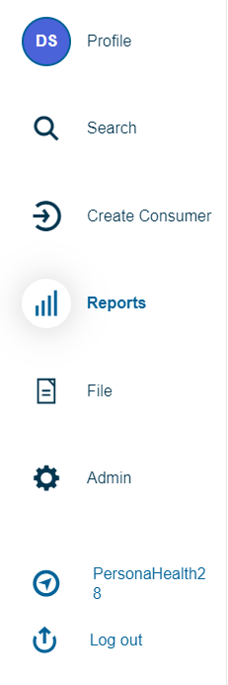
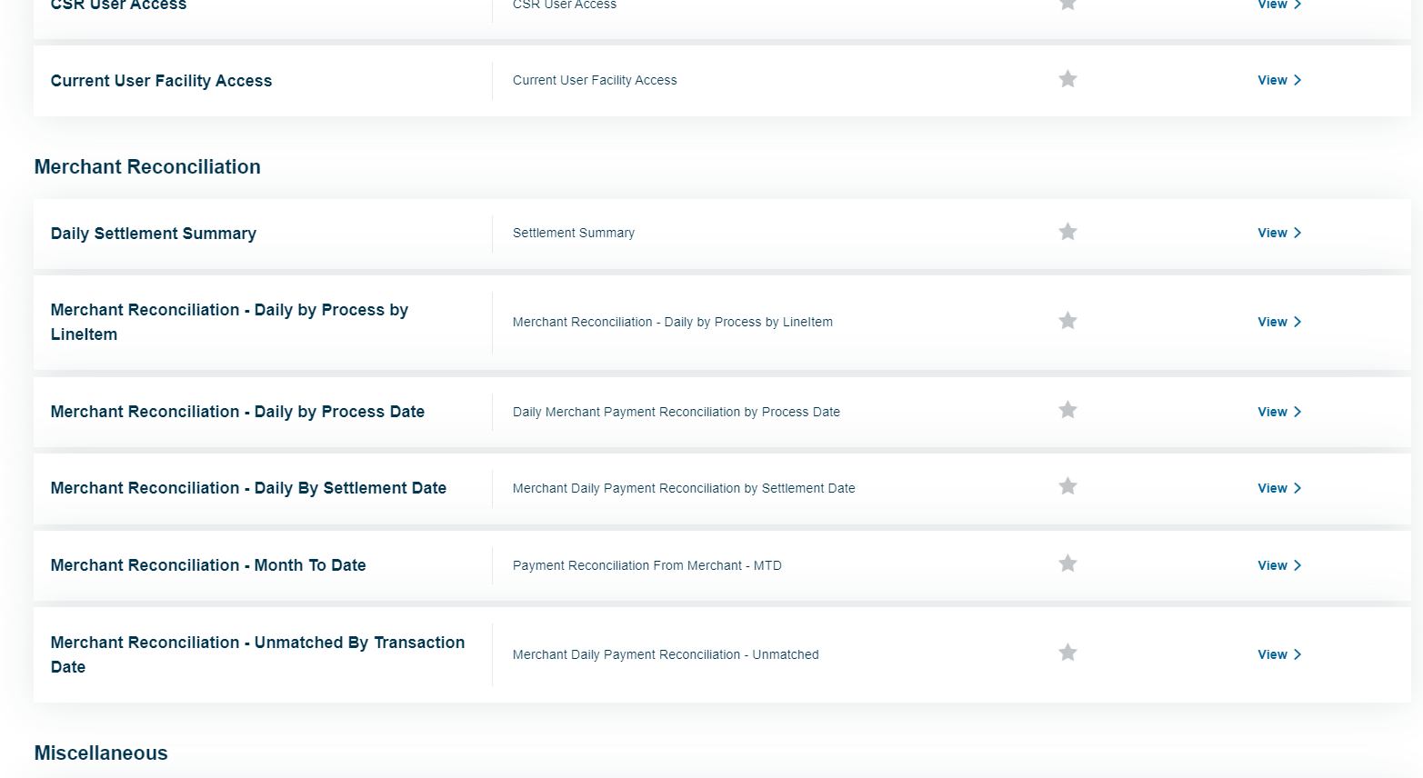
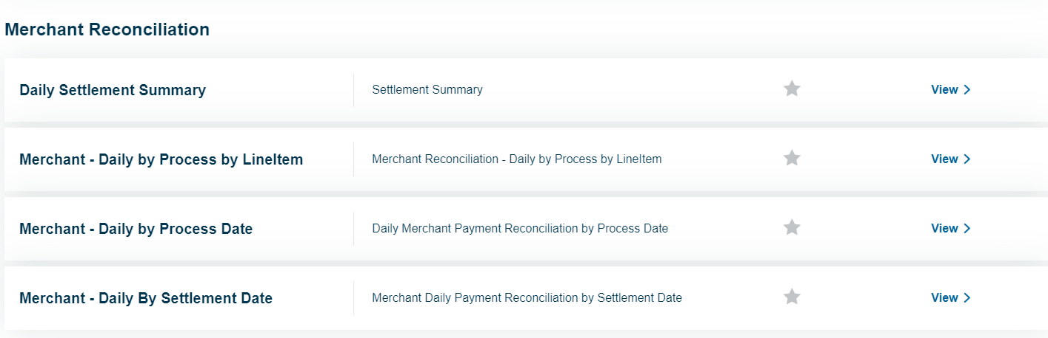

Cut reconciliation in half with settlement-based reconciliation (SBR)
A complimentary reporting tool provided to all RevSpring Merchant Services customers.
Payment Summary
View what has transpired over the day. Monitor individual and team performance.
Payment Remittance File
File is posted back into client’s host system to update accounts and ensure it remains the system of truth.
Settlement-based Reconciliation
Shows whether the payments taken by the software equate to what was funded in the client’s bank account.
RevSpring’s SBR tool consists of (4) reports located in the Merchant Reconciliation section of RevSpring’s PersonaPay CSR portal.
Notes:
Our SBR tool lives in the PersonaPay CSR portal and ships with four reports designed for daily balancing and fast research. The promise is simple: payments taken through RevSpring equate to the dollars deposited—visible, traceable, and explainable from one screen.
Would a daily ‘funds vs. settlements’ snapshot reduce the end-of-day scramble?
Why SBR?
Ensure payments taken by your RevSpring technologies (portal, IVR, devices, text-to-pay) equate to the dollar amounts deposited in your bank.
SBR automates this process by displaying all the information you need to balance (and research imbalances) in one place.
Payment Summary: Real-time
Transactional level detail
This report shows ALL transactions (attempted, declined, approved, etc.) made at the technology/portal level.
Remittance File: Daily
(Automated File Transfer)
Factual listing of all payment transactions that have happened.
This file contains ALL transactions that occurred each day across our payment channels (23:59:59)
SBR: Available ~2 business days following batch close
These reports reconcile daily electronic transactions
(Credit Card and ACH payments

Slide 30
Single source provider that minimizes cost, reduces risk, and closes the loop on every patient payment
Meet or Beat
Guarantee
RevSpring has every angle covered to provide you a cost effective, fast, reliable and secure way to fulfill your patient’s payments.
Simplify processing with an all-in-one platform for credit,
ACH, and digital wallets.
Minimize costs with no extra gateway fees — save up to $0.10
per transaction + monthly fees.
Streamline and automate reconciliation across all
departments and locations.
Top tier security to protect cardholder data. PCI Level 1
hosted environment with tokenization and encryption.
Flexible, patient-preferred payment options — cards, ACH,
and digital wallets across web, text, and phone
Current clients are
saving 5-10%
on processing fees
Free rate analysis
with 3 months of consecutive credit card statements
Notes:
With RevSpring you simplify processing across cards, ACH, and digital wallets—eliminating extra gateway fees that can run up to $0.10 per transaction + monthly fees. Add top-tier security—PCI Level 1 hosting, tokenization, encryption—and a full spectrum of patient-preferred options via web, text, and phone.
Current clients are saving 5–10% on processing fees. We stand behind a meet-or-beat guarantee and offer a free rate analysis—just share three months of statements. We’ll show the savings line by line and model the operational lift from SBR.
Should we schedule a 30-minute merchant demo and start the rate review with your latest statements?

Slide 31
SalesVu + RevSpring
Dynamic in-store POS and eCommerce solution
for Health System non-patient settings
Single, unified platform to eliminate data silos
Revenue visibility from transaction to funding
Convenient retail experience for customers
Seamless reconciliation of patient and
non-patient revenue
Real-time visibility across locations and revenue units
Competitive merchant rate
One solution for patient payments & non-patient revenue.
Notes:
SalesVu and RevSpring come together to give health systems a single solution for both patient payments and non-patient revenue.
SalesVu powers in-store POS and eCommerce for retail environments like gift shops, cafeterias, and wellness centers, while RevSpring handles patient payments—all on one unified platform.
That means no more data silos. You get full revenue visibility from the moment a transaction happens all the way through funding, with seamless reconciliation across patient and non-patient revenue.
Operationally, teams get real-time visibility across locations and revenue units. From a consumer perspective, customers get a modern, convenient retail experience.
And because it’s all part of RevSpring Merchant Services, you also benefit from competitive merchant rates and a single vendor to support and manage the entire ecosystem.

Slide 32
Analytics
Transforming Patient Engagement
Through Insight-Driven Payments
Notes:
Healthcare organizations are collecting more data than ever — clinical, financial, engagement — but very little of it is connected in a way that drives action. The result is delayed decisions, missed revenue opportunities, and inconsistent patient experiences.
This is where analytics become a growth lever — not just reporting, but insight-driven payments.
Q: Would you say your data today helps your team decide what to do next, or mostly tells you what already happened?

Slide 33
Unify analytics to improve patient engagement and payment outcomes
Predict
Three unique scores to maximize yield
found nowhere else in the industry:
Propensity to Pay
Payment Optimization
Financial Assistance
Design
Use proven design and analytics to boost
statement effectiveness
Dashboard
Real-time access to the data that drives
decisions, patient engagement and better
payment outcomes
Engage IQ™
Segments each patient into key groups
and provides unique messaging for each
patient profile
Notes:
RevSpring is unique in that we don’t stop at reporting. We generate meaningful/actionable strategy that can help drive workflows.
RevSpring’s analytics work together to drive better outcomes, not in isolation, but as a connected system.
We start with intelligence. Using our predictive scoring — propensity to pay, payment plan optimization, and financial assistance — we understand each patient’s situation before we ever communicate with them. That allows you to move away from one-size-fits-all billing to precise personalized strategies.
That intelligence then directly informs how we engage patients. It drives statement design, messaging, channel selection, and payment options — so patients see information that’s clear, relevant, and appropriate for their situation. This is where we see faster resolution, higher self-service, and fewer inbound calls.
At the same time, everything is continuously monitored. Our real-time dashboards show what’s working, what’s not, and where adjustments are needed — so teams aren’t waiting weeks for reports or guessing why performance changed.
Engage IQ brings it all together by diving even deeper and segmenting your entire patient population into meaningful groups and orchestrating personalized journeys for each one. Every patient gets the right experience, through the right channel, with the right financial option — automatically and consistently.
The result is better payment outcomes, lower operational effort, and a patient experience that feels fair, personalized, and intentional, because analytics aren’t just informing decisions, they’re driving action.
Q: The result is better payment outcomes, lower operational effort, and a patient experience that feels fair, personalized, and intentional — because analytics aren’t just informing decisions, they’re driving action.
Q: Do you have visibility into which engagement strategies are actually driving payments versus just generating activity?
Note: Engage IQ Includes all.

Slide 34
RevSpring Predict
Predict
More precise than credit score-based models which can be invasive and less inclusive of your whole patient base.
How a score is generated
Data
Public Record Data collected from thousands of sources and organized into a centralized database.
Consumer Linkage
Data aggregated at the consumer level developing a meaningful consumer profile for every individual.
Analytics
Profile is then used in proprietary algorithm to derive a predictive score.
+
= SCORE
Predictive Analytics = Predicting the future by using data from the past.
Notes:
RevSpring Predict is fundamentally different from traditional credit score–based models. Credit scores can be invasive, incomplete, and often exclude large portions of the patient population. Predict is designed specifically for healthcare and built to be inclusive of all patients.
Here’s how it works. We start with public record data collected from thousands of sources and organized into a centralized database. This gives us a broad, stable foundation without relying on sensitive or invasive credit pulls.
Next, we apply consumer linkage — aggregating that data at the individual level to create a meaningful, unified consumer profile for each patient. This step ensures we’re scoring the person, not just an account or a transaction.
That profile is then used within RevSpring’s proprietary analytics to generate a predictive score. We combine historical demographic and behavioral data to anticipate future payment behavior — because predictive analytics is ultimately about using the past to make better decisions going forward.
The result is a more precise, more equitable score that helps organizations confidently decide how to engage patients, when to engage them, and what options to present — without excluding or alienating parts of the patient base

Slide 35
Score each patient appropriately based on individual factors
Propensity
RevSpring uses historical data to weigh the demographic and behavioral scores appropriately for each patient.
For example, if a patient has little history with the hospital, the demographic score will be weighted high (and vice versa).
Model outcome:
Low propensity
Medium propensity
High propensity
Scoring Segmentation
Demographic Score
Behavioral
Score
Notes:
Predict balances demographic data with real behavioral history — adjusting the weight depending on how much interaction the patient has had with your organization. This avoids over- or under-estimating a patient’s ability to pay.
Q: Do you see patients with similar balances behaving very differently today?
Q: Are you using any external data today to inform payment decisions — or just internal billing history?

Slide 36
Optimize Payment Plans
Within Your Rules
Payment Plan Optimization
Improve payment outcomes by offering payment plans—to the right patient, with the right terms, within organizational guidelines.
Pinpoints Payment Amount
Increases the likelihood that patients accept and fulfill payment plans
Sweet
Spot
Options Align with your
Pre-Determined Guidelines
Present an even more precise payment plan
Calculates Best Plan Timeframe
Integrates with PersonaPay for additional
patient self-service to adjust payment terms within your guidelines
Notes:
The Payment Plan Optimization score determines how a patient should pay — identifying the right payment amount and timeframe within your policies. It finds the ‘sweet spot’ that patients are most likely to accept and complete, reducing defaults and rework.

Slide 37
We monitor your campaign performance and make recommendations for change
Insights
Testing
Monitor
Performance
Split test workflows to improve performance and test communication elements such as:
  Design Elements
  Channel
  Timing
  Message Content
Are your patient communications having the desired impact on your cash and KPI’s?
Continue to refine patient segments and engagement strategy.
Learning
Adjust workflows based on performance measurement & testing.
Notes:
After go live we measure your campaign performance to make sure you’re getting the results you wanted. Because of our nimble campaign engine, our RevSpring Analytics team can go in and edit campaigns without long turnaround times. Some of the things we might focus on include design elements on the statement, channel messaging, timing that reminders go out, as well as how we message / actual verbiage.

Slide 38
Redefining Print in a Digital Healthcare World
Print Reinvented: Secure.
Intelligent. Impactful.
Notes:
Print isn’t going away in healthcare — it’s evolving. Even as digital adoption grows, print remains a critical, trusted channel for financial and clinical communications. The question is whether print is working harder for you, or simply costing more.

Slide 39
The evolution
What you can expect from RevSpring:
Reliability & resilience – Multi-site production with disaster recovery and clear recovery objectives.
Address intelligence – Continuous cleansing, NCOA, suppression, and return-mail automation.
Self-service control – Ability to update templates and messaging without tickets and long timelines.
End-to-end visibility – Real-time tracking from file receipt through print, mail, and delivery status.
Integration with payments & digital – Print that drives patients effortlessly into portals, call centers, and payment options.
Notes:
RevSpring delivers reliable, multi-site production with built-in disaster recovery, so critical communications never stall. We continuously cleanse address data to reduce waste and returned mail.
Teams gain self-service control to update messaging without delays, full end-to-end visibility into every file and piece, and tight integration with payments and digital channels — so print actively drives patient action, not just delivery.
That’s what modern healthcare print looks like: resilient, intelligent, and fully connected.

Slide 40
Fast and easy tech integration
  We support diverse technology environments. From legacy to cutting edge platforms with any PM, EMR, EHR:
  We support batch (SFTP) and real-time API integrations
  Accept raw data to fully composed (ready to print) documents
  Flexible archive and delivery
  Customized reporting
Typical implementations take
only three weeks!
Our secure, scalable platforms ensure reliable performance across all integration points with
Notes:
Minimize disruption for IT and operations. Fast integration means faster value. RevSpring integrates with legacy and modern systems using batch or real-time methods, with most implementations live in about three weeks.

Slide 41
Return Mail Management
Customize business rules to address specific undeliverable codes (IMB/STID)
Securely destroy undelivered documents
so Employees focus
on service, not piles of returned mail.
U.S.P.S Reports
3 to 4%
Returned Rate for
First Class Mail
After initial delivery attempt, test NCOA
and capture reason-code for non-delivery
Update contact
database, ACS
digitizes and delivers returned mail updates
Notes:
Returned mail is silent waste. RevSpring proactively manages returns using USPS data to reduce unnecessary re-mailing and cost.
Q: Do you know how much returned mail costs you annually?
Post-USPS – Returned Mail & Benefits of ACS™ :
Cost Savings - with reduced undeliverable mail
Data Accuracy – Change of Address or reasons for non-delivery
Eliminate physical returned mail
Retrieve address change information electronically via a secure Internet site to allow automated updating of mailing lists.
Increase - deliverability & engagement rates
Reallocate Staff - intensive address change functions by eliminating returned mail

Slide 42
RevSpring Retrieve
Document
Management Service
Long-Term Retention and Access for Consumer Communications
Quick visibility to an exact document when on a call with a patient
Extended-period storage
and customizable retention
Exact replica of all communications including email and SMS
Custom search and view
options
Notes:
Exact replicas of all communications protect staff, speed dispute resolution, and support better patient conversations.
Exact replica archive of all delivered communications – both printed and digital in one platform
Extended-period storage and retention customizable to your needs:
State compliance laws
Internal policies
Quick visibility to the exact document when on a call with a patient
Custom search and view options
Q: Do staff ever struggle to find past communications?

Slide 43
End-to-end benefits
Document
Management Service
Peace of
Mind
Instant
Knowledge
Efficiency & Convenience
Customer
Service
Insight and control into every aspect of the digital and print communication process
Immediate access to all communication information via portal or integration
Easy to track, review, store, and report all communications in one platform
Support patients & empower staff by having exact communication replicas at your staff’s fingertips
Notes:
The result is confidence, speed, efficiency, and better patient service — all from one connected platform.
Q: Which of these benefits would have the biggest impact for your organization?

Slide 44

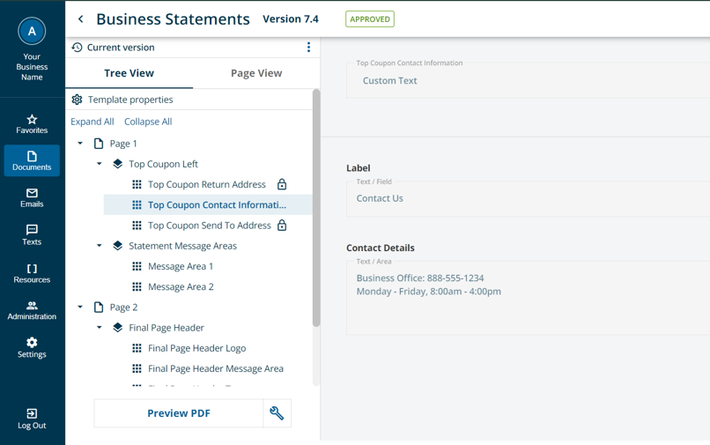
Self-serve with RevSpring Composer
Document Template Changes At Your Fingertips
How it Works
Select your template in the platform
View all document elements:
  For locked elements:
  You can view what will appear in that section
  For unlocked elements:
  You can adjust either the text or
  image within that section
What can be changed:
  Logos
  Static text
  Dynamic text fields
  Layout and content locations
Notes:
Composer gives teams the ability to update templates quickly and safely — reducing delays and risk.
Q: How often do document changes get delayed today?

Slide 45
Value that makes an impact
Peace of Mind
Efficient Change Management
Know that changes to documents are handled properly
Simple template changes with adjustable user permissions
More Targeted Communications
Faster Adjustments to Templates
Easily duplicate and make changes to templates, enabling simple customization
Basic changes can be quickly made all within the platform interface
Seamless Approval Process
Quick to Adapt
Approve changes from
right within the platform
In-house tool from RevSpring means Composer can quickly adapt to changing client needs
Notes:
When print reduces confusion, lowers cost, and accelerates payment — it becomes a strategic asset, not just an expense.
Would it be valuable to see how this could look in your environment — using your workflows and communication volume?

Slide 46
The Omni Brain
Patient Engagement You Can See,
Optimized For Outcomes

Slide 47
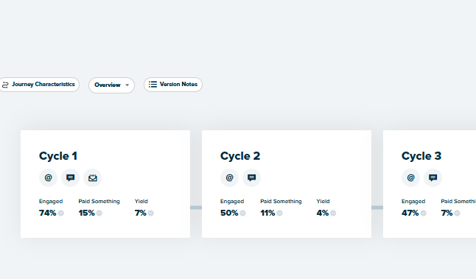
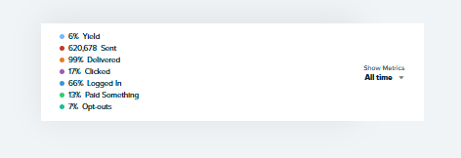
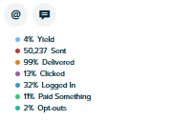
Meet Omnibrain: A more intelligent way to engage
The power to personalize and optimize, right at your fingertips.
See how every campaign performs in real-time
Patient Engagement Platform
Easily create, edit, and optimize patient journeys without IT or vendor support
Tailor communication by persona, behavior, and channel preference
Leverage AI insights to continually improve results and outcomes
Notes:
The Engagement Engine puts the power of personalized communication and real-time optimization directly in your hands.
It gives you full performance visibility, allowing you to see how every campaign is performing through clear, visual dashboards — no more guesswork, no waiting on reports.
From there, you can control and customize patient journeys yourself — adding touchpoints, adjusting timing, or testing new strategies — all without needing IT or vendor support.
It’s designed to make engagement as dynamic as your patients are, with AI guidance to suggest improvements and help you optimize for better results over time.
In short, the Engagement Engine combines intelligence, transparency, and control — so you can drive measurable outcomes with every interaction.

Slide 48
Turning insight into action
20%
Average Increase in
Self Service Payment
Up to 30%
In reduced
postage costs
Double
Response When Channels Work Together
Payments received
on average
6.5 days faster
Low opt-out rates of around
1% per touchpoint
90%
Pre-Service
Response Rate
Notes:
With the Engagement Engine, our clients are seeing measurable improvements across the board.
They’re driving more self-service as patients engage digitally, reducing postage and operational costs, and seeing faster payments thanks to smarter, data-driven communication.
What’s most exciting is the reach — organizations are connecting with a higher percentage of their patient population through digital channels, creating more consistent engagement and stronger relationships.
Together, these gains translate into better financial outcomes for providers and better experiences and care outcomes for patients

Slide 49
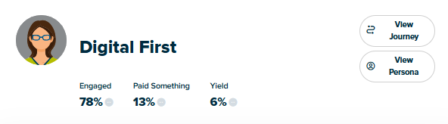

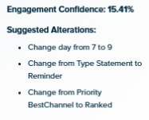
How OmniBrain works
Personalize
Engage
Measure and Optimize
Convert patient data into insight:
Predictive data
Demographic data
Situational data
Behavioral data
Create personas:
Patients with similar characteristics share tailored journeys
Measure performance by persona
Measure performance by touchpoint
Dynamically adapt the best channels to each patient
Dynamically adapt the journey path based on patient action
Refine personas
based on actions, AB testing
People with these characteristics are more likely to respond.
Notes:
Here’s how it works — we take what you already know about your patients and turn that data into actionable insight.
Using intelligent segmentation, we create personas that group similar patients together based on their behaviors, preferences, and responsiveness. Each persona follows a tailored journey path designed to drive the best possible outcomes.
Those journeys are dynamic — they adjust automatically based on how each patient interacts with your communications. Whether a patient responds immediately or needs an extra reminder, the system adapts to create a personalized experience that inspires action, improves engagement, and ultimately delivers better outcomes for both patients and providers.

Slide 50
Personalized patient engagement at your fingertips
Centralized Consent
& Channel Preference
Tracks patient consent and preference, and prioritizes channels based on behavior.
Integrated Performance
Results are tied to the engagement platform and immediately visible.
Personas
Group together patients that share characteristics that may influence their communication engagement tendencies.
Outcome-based Engagement
OmniBrain’s intelligence enables users to deliver dynamic patient communications tailored to achieve business goals—for any leg of the journey.
Engagement Journeys
Individualized communication strategies are organized into a journey format, which provides a dynamic path to follow for each individual patient outreach.
Self-service Journey Adjustments
Instantly adjust touchpoint timing, channels, and message templates to optimize outcomes.
Notes:
The Engagement Engine brings together everything providers need to manage, measure, and optimize patient communication — all in one place.
It starts with centralized consent and channel preferences, so every message is sent the way patients want to receive it. You’ll have integrated performance dashboards to see what’s working in real time and adjust campaigns on the fly.
Personas and journeys help you tailor communication around patient needs and behavior, driving engagement that’s truly outcome-based — whether the goal is payment, scheduling, or education.
And with self-service adjustments, providers can make updates instantly without waiting on IT or vendor support — giving you total control over your engagement strategy.

Slide 51
One platform, leveraged by all
Marketing
Build Brand Affinity & Loyalty
IT
Streamline Systems
Improves coordination
across teams and touchpoints, from access to revenue cycle
Revenue
Cycle
Increase Yield
& Reduce Cost
to Collect
Practice
Manager
Automate Workflow
One platform for every patient communication need
Simplifies
communication workflows
for every department
Clinicians
Improve Quality
of Care
Digital/
Patient Experience
Increase Satisfaction & Loyalty
Notes:
The Engagement Engine isn’t limited to one use case — it’s designed to support any department that needs to connect with patients.
From marketing campaigns and revenue cycle outreach to clinical communication and care coordination, each team can build personalized journeys that align with their goals.
It’s a single platform that unites your organization’s engagement strategy — helping every department communicate smarter and more effectively.

